Slide 1

Decision Tree Learning and Representation
Presented By:
S.Sri Sai Prasanna Durga (192424241)
ITA0601- Machine Learning

Slide 2
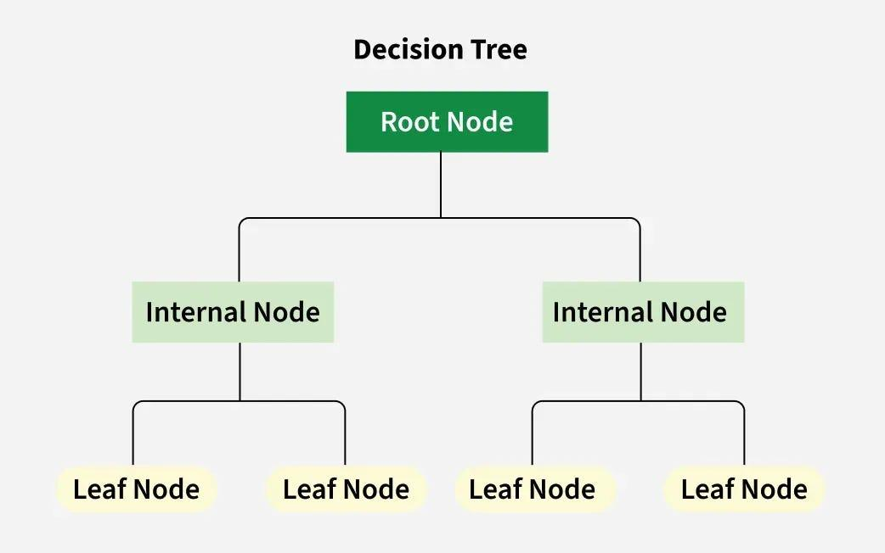
INTRODUCTION
Decision Tree Learning is a supervised machine learning algorithm used to solve classification and regression problems.
It builds a tree-like model that represents decisions and their possible outcomes.
It starts with a root node, where the most important feature is selected for splitting the data.
Each internal node represents a test or condition on a feature.
Each branch represents the outcome of a decision or test.
Each leaf node represents the final predicted class or output value.

Slide 3
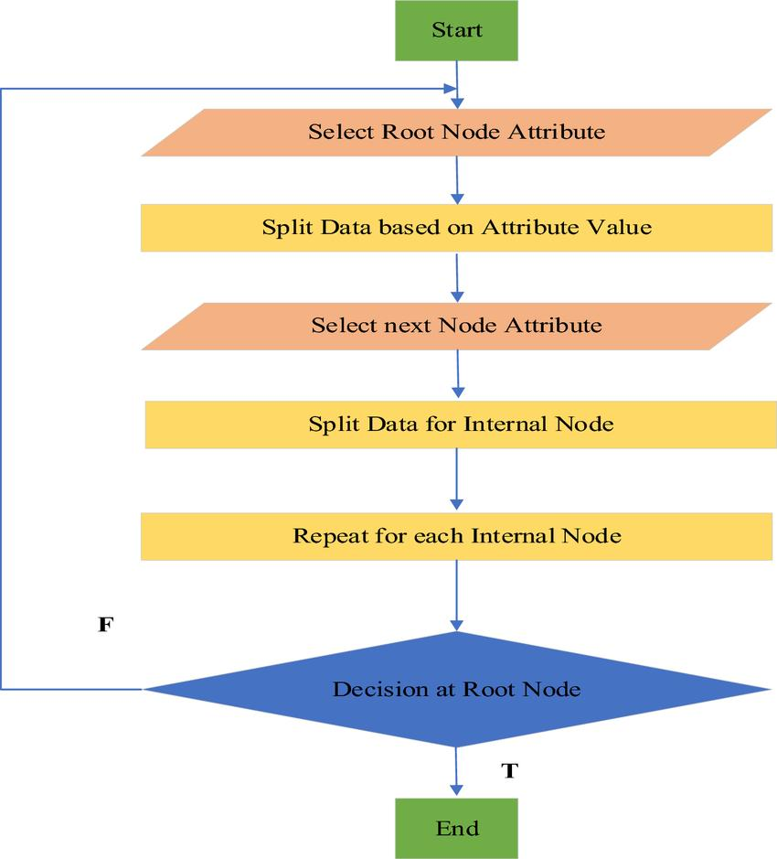
WORKING OF DECISION TREE LEARNING

Slide 4
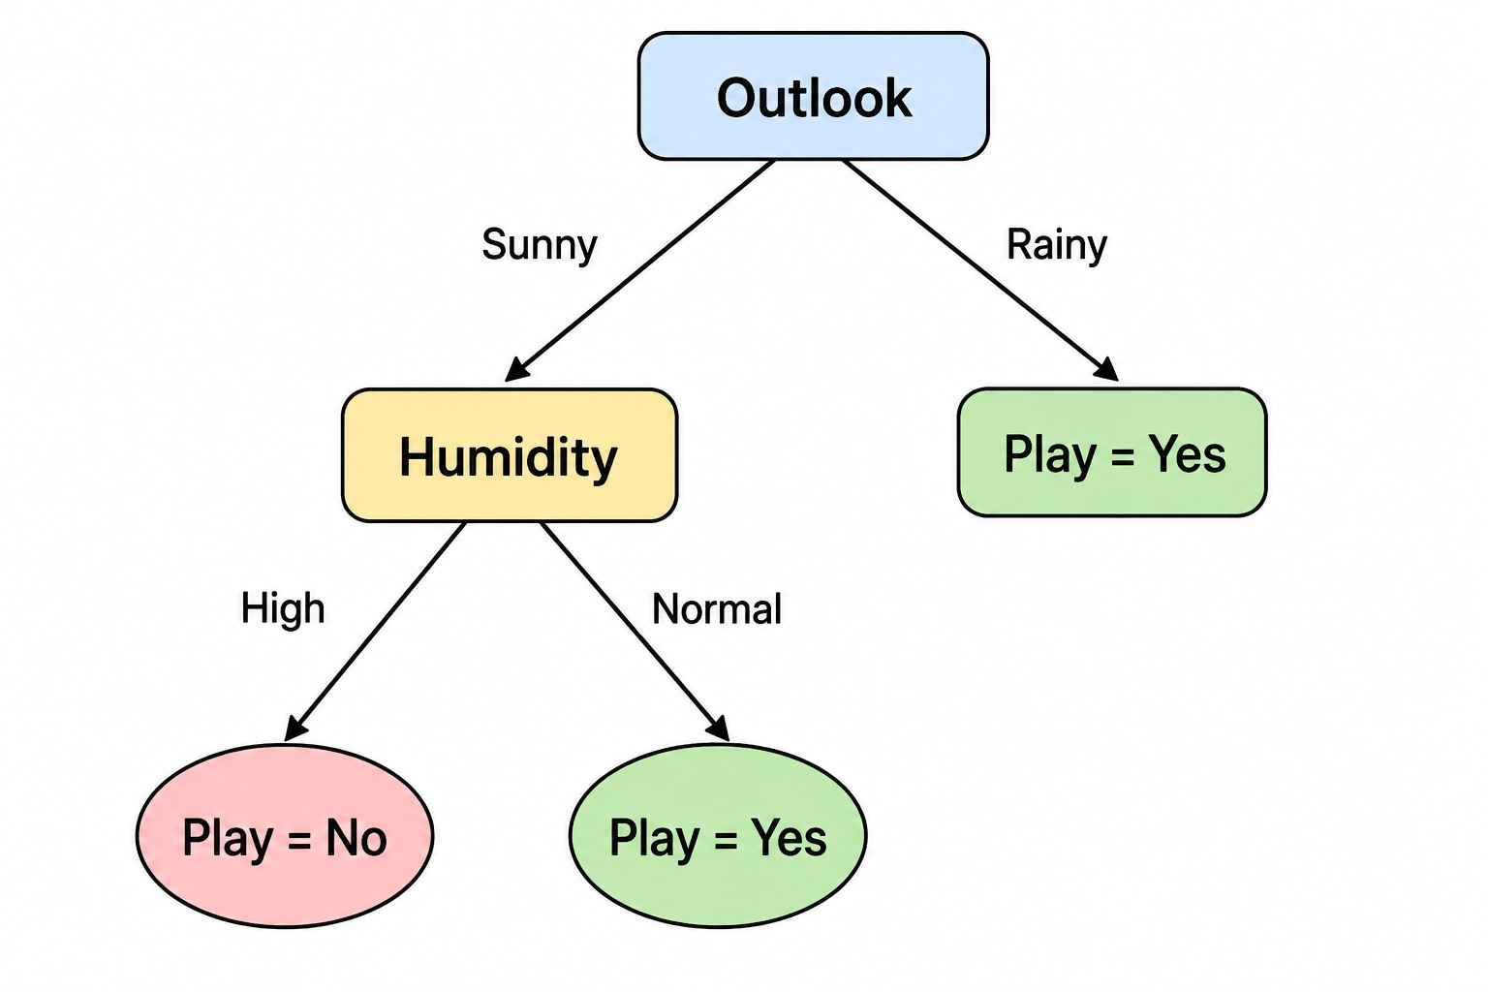
KNOWLEDGE REPRESENTATION
It is the process of representing learned knowledge in a tree-like structure using nodes and branches.
The tree converts data into simple IF–THEN decision rules that are easy to understand and interpret.

Slide 5
ENTROPY:
Entropy measures the impurity or randomness of the dataset.
Formula: Entropy(S)
= - Σ pi log₂(pi)
Where
pi = Probability of each class
INFORMATION GAIN:
Information Gain measures how much uncertainty is reduced after splitting.

Slide 6
Formula:
Information Gain = Entropy(Parent) − Weighted Entropy(Children)
TREE PRUNING:
Tree pruning removes unnecessary branches.
Types:
1.Pre-Pruning
Stops tree growth early.
2.Post-Pruning
Build complete tree and remove unnecessary branches.

Slide 7
ADVANTAGES:
✔ Easy to understand
✔ Easy to visualize
✔ Handles numerical and categorical data
✔ No data normalization required
✔ Fast prediction
LIMITATIONS:
Overfitting
Sensitive to noisy data
Can become very large
Lower accuracy than ensemble methods
APPLICATIONS
Disease Diagnosis
Loan Approval
Fraud Detection
Spam Email Classification
Customer Churn Prediction

Slide 8
CONCLUSION
Decision Trees are one of the most popular supervised learning algorithms.
They use Entropy and Information Gain to build an optimal tree.
Tree Pruning improves generalization and reduces overfitting.
They are widely used for classification and decision-making because they are simple, interpretable, and effective.

Slide 9


